Slide 1
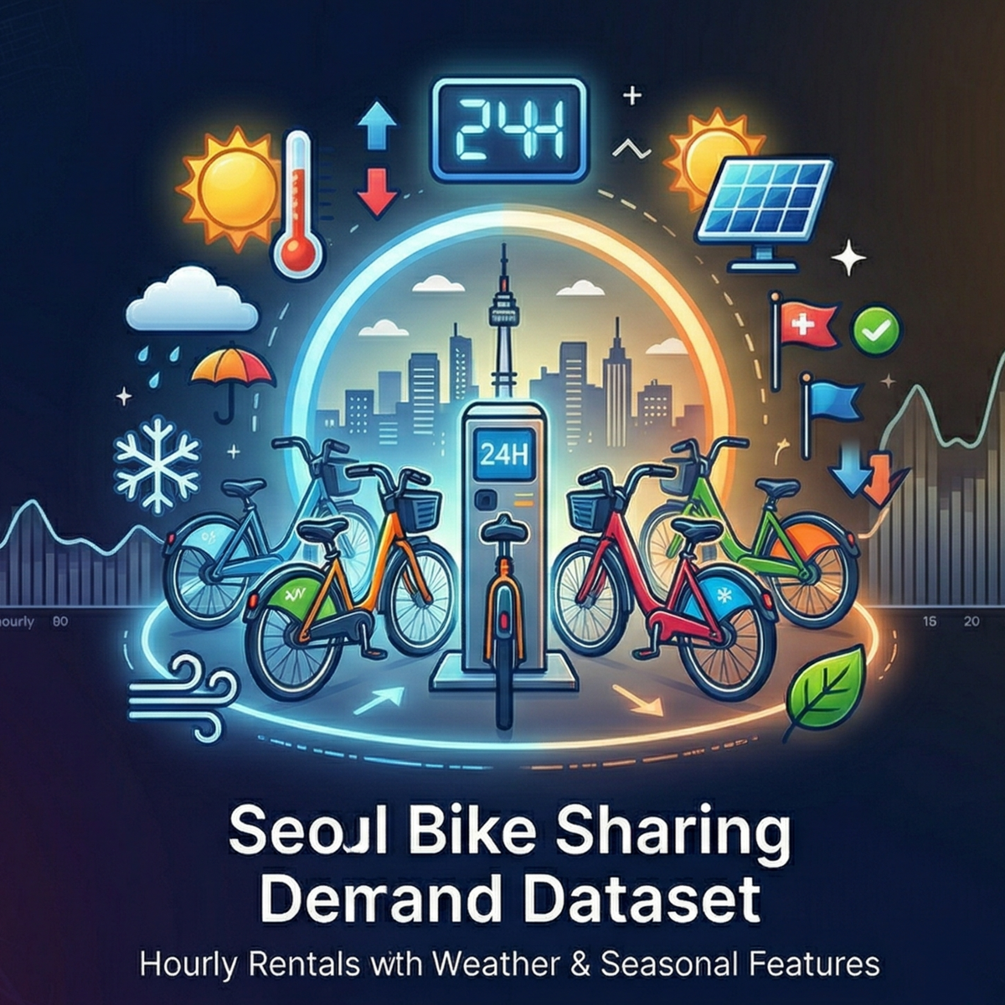
PRESENTED BY : SHRADDHA KAMBLE
GUIDED BY: ABHISHEK WAHWAL

Slide 2
Summary of my project
The dataset contains hourly bike rental data for one year.
It includes weather, time, and seasonal features that influence demand.
The main target variable is Rented Bike Count.
Key Points
Time Effect:
Rentals are highest during morning and evening (office commute hours).
Temperature:
Moderate temperature increases bike usage.
Weather Impact:
Rainfall and snowfall reduce bike rentals significantly.
Seasonal Trend:
  Summer & Autumn → High demand
  Winter → Low demand
Holiday Effect:
Rentals are higher on working days compared to holidays.

Slide 3
Problem Statement
The goal of this project is to analyze and predict bike rental demand using historical data from the Seoul bike sharing system.
Bike rental demand varies based on multiple factors such as time of day, weather conditions, seasons, and holidays. Accurately predicting this demand is important to ensure optimal bike availability, reduce shortages, and improve user satisfaction

Slide 4
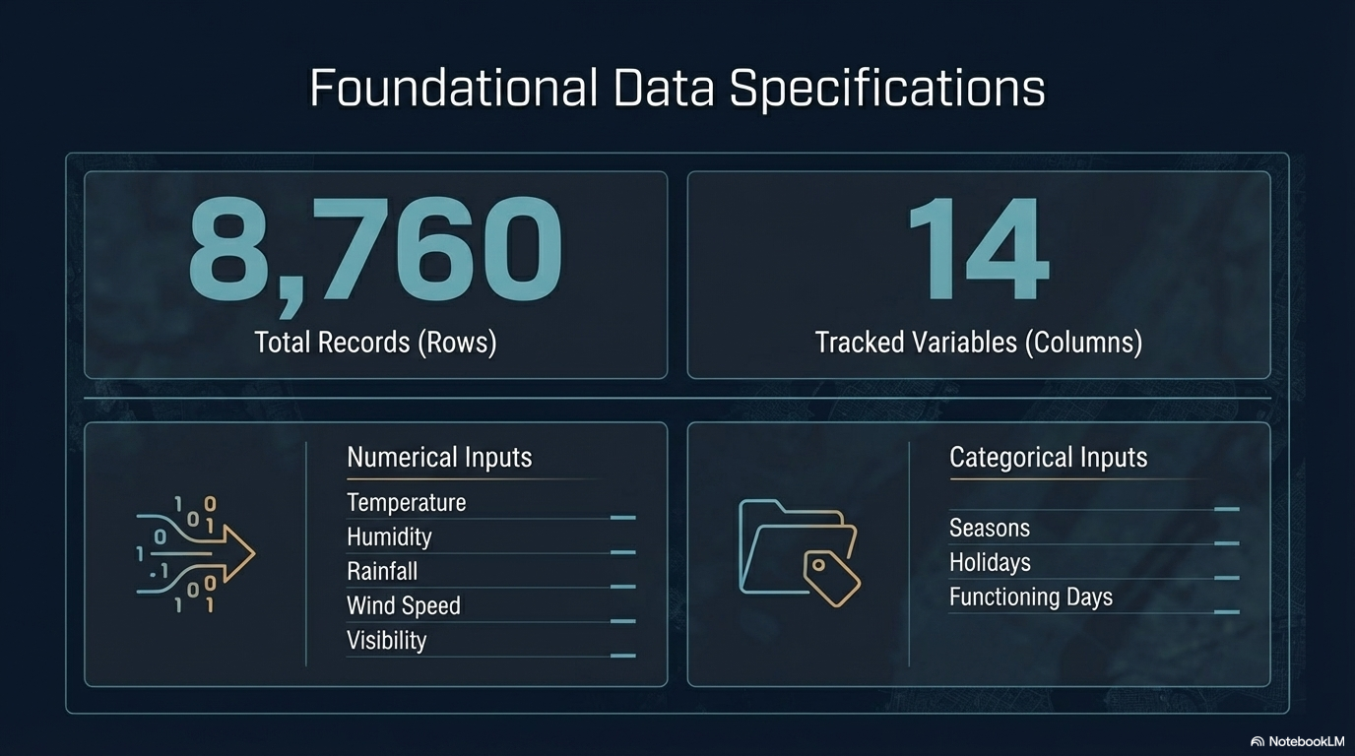

Slide 5
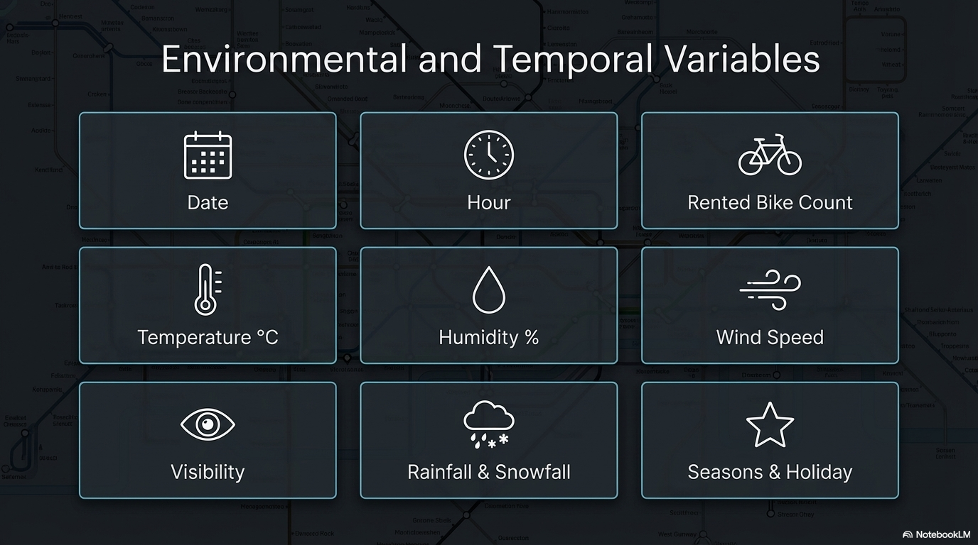

Slide 6
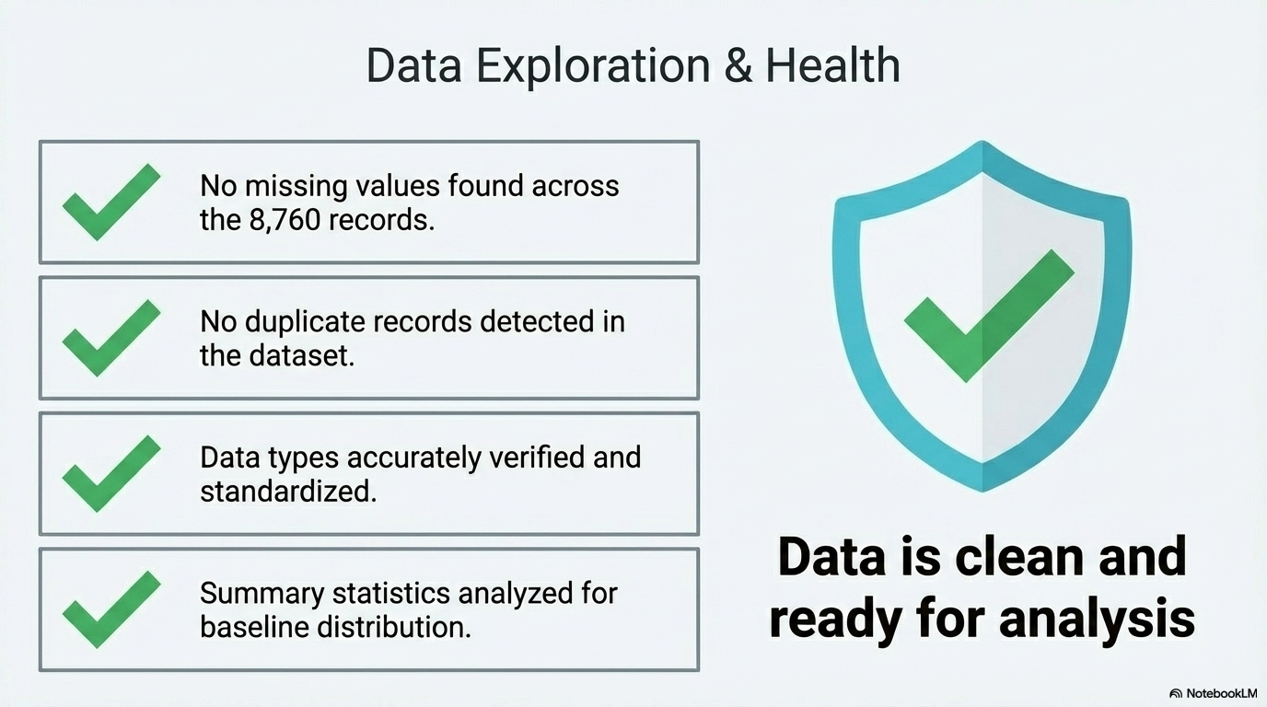

Slide 7
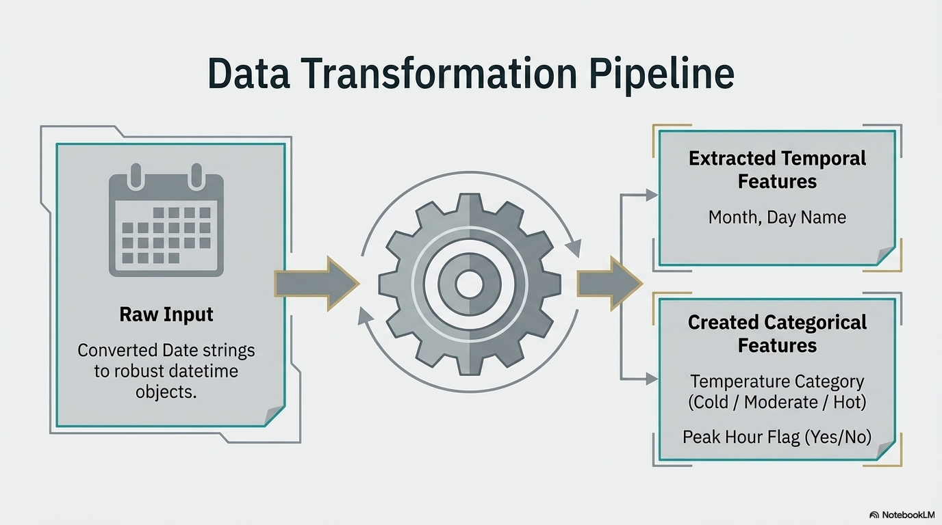

Slide 8
Filtering Insights
High Rentals demand when Temperature > 25°C which increase in bike rentals
Rental Drop During Rainfall & Snowfall When Rainfall > 0 which decrease in bike rentals
When Snowfall > 0 Winter Season Shows Low Demand which lowest demand period

Slide 9
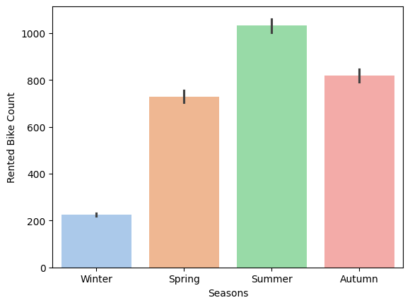
Data Visualization
Seasonwise Bike Rental insights
From the Bar chart:
Winter (~230 rentals)
  Lowest demand
  Cold weather + snowfall reduces usage significantly
Spring (~730 rentals)
  Moderate increase in demand
  Comfortable weather encourages usage
Summer (~1030 rentals)
  Highest demand
  Warm temperature → peak bike usage
Autumn (~820 rentals)
  Slight drop from summer
  Still strong demand due to mild weather
.

Slide 10
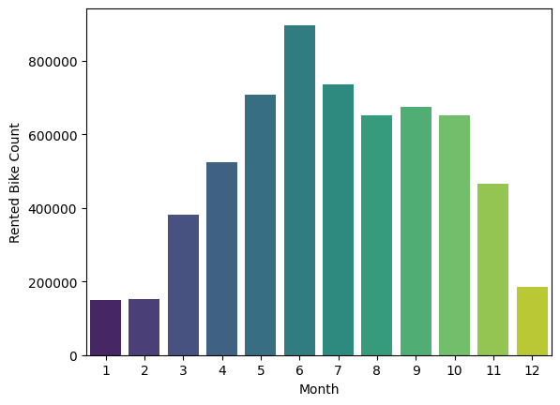
Data Visualization
Monthwise Bike Rental Insights
From the Bar chart:
Jan–Feb (Months 1–2)
  Very low rentals (~150K–180K)
  Peak winter → lowest demand
Mar–May (Months 3–5)
  Strong growth (~380K → 700K)
  Transition to pleasant weather
June (Month 6)
  Peak demand (~900K)
  Ideal temperature → highest rentals
Jul–Oct (Months 7–10)
  Slight decline but still high (~650K–750K)
  Possible rainfall impact
Nov–Dec (Months 11–12)
  Sharp drop (~470K → 180K)
  Entry into winter season

Slide 11
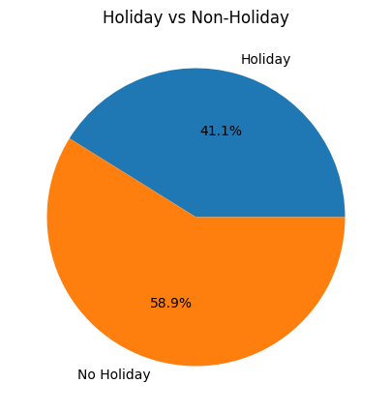
Data Visualization
Holiday VS Non Holiday Rental Insights
From the Pie chart:
Non-Holiday (58.9% rentals)
  Higher bike usage
  Driven by daily commuting (office, school, routine travel)
Holiday (41.1% rentals)
  Lower bike usage
  Reduced commuting → fewer rentals

Slide 12
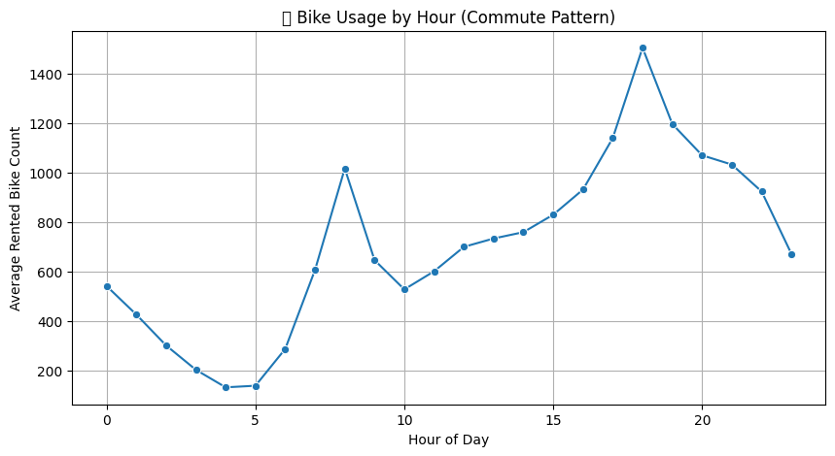
Data Visualization
Bike Usage by hour (Commute Pattern)
From the Line chart:
Metric | Hour (24h) | Approx. Bike Count
Daily High | 18 (6:00 PM) | 1,500
Morning High | 8 (8:00 AM) | 1,000
Daily Low | 4 (4:00 AM) | < 200
Mid-day Average | 12 (12:00 PM) | 700

Slide 13
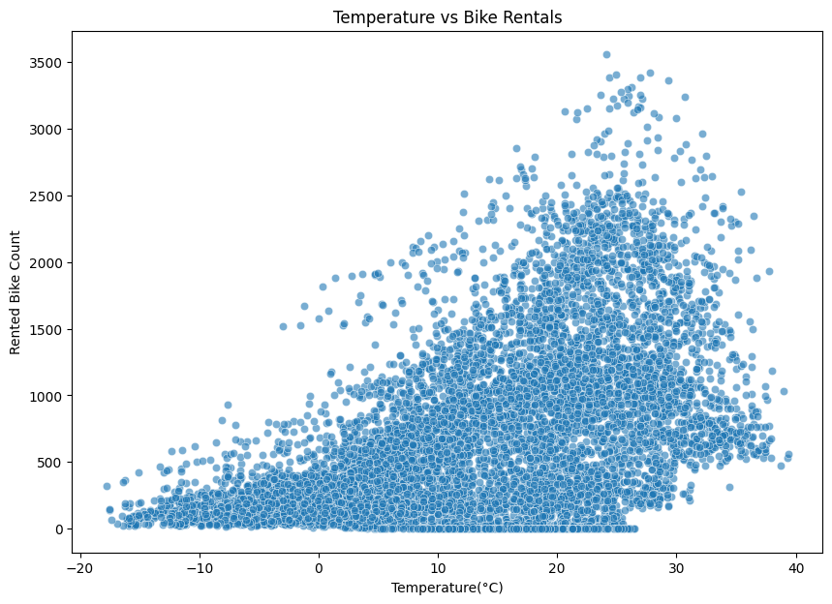
Data Visualization
Temprature VS Bike Rental Insights
From the Scatter chart:
Temperature Range | Rental Activity | Observations
Below 0°C | Very Low | When it's freezing outside, very few people rent bikes
0°C to 15°C | Moderate | As the weather starts to warm up, more and more people begin to rent bikes.
20°C to 30°C | Peak | Maximum demand; most data points are concentrated here.
Above 35°C | Declining | A noticeable drop-off as it becomes "too hot."

Slide 14
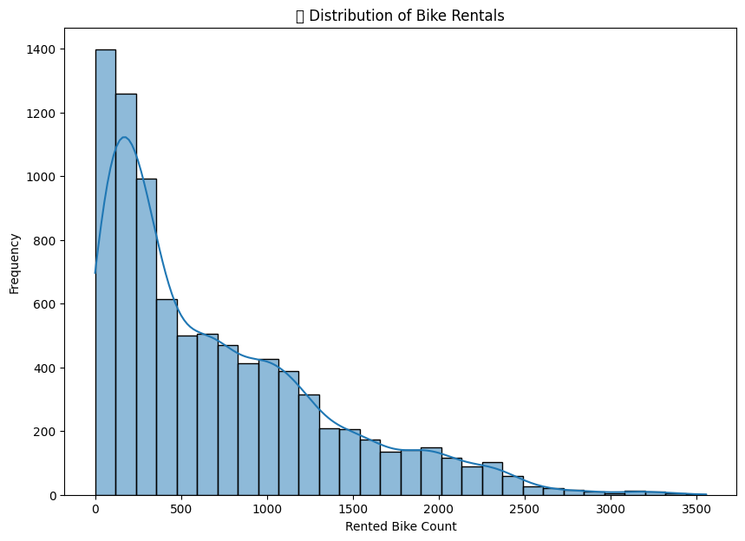
Data Visualization
Frequency VS Bike Rental Insights
From the Histogram chart:
Rental Count | Frequency (How often it happens)
0 – 500 bikes | Very High: This is the most typical situation.
500 – 1,500 bikes | Moderate: These counts happen often, but less than the low counts.
1,500 – 2,500 bikes | Low: It is much less common to see rentals in this high range.
Over 2,500 bikes | Rare: These "peak" events almost never happen.

Slide 15
Key Insights
Peak demand during commuting hours
Summer season has highest rentals
Rain & snow reduce usage
Temperature positively affects demand

Slide 16
Business Recommendations
Increase bikes during peak hours
Add more bikes in summer
Reduce operations in extreme weather
Introduce offers during low-demand periods

Slide 17
Conclusion
Strong relationship between weather & bike demand
Time and season are key factors
Data-driven decisions can improve efficiency

Slide 18
Thank You

